Slide 1



Negative Equity:
A Continuing Problem
March 17, 2015
Spencer M. Cowan | Vice President
Woodstock Institute | Chicago, Illinois
P 312.368.0310 | F 312.368.0316
scowan@woodstockinst.org
@woodstockinst
WoodstockInstitute

Slide 2
Overview
Thanks and disclaimer
Context for discussion of negative equity
  one of many symptoms of distress
Distribution of the problem, data from:
  Chicago – end of 2011
  Underwater America – end of 2013
Policy implications

Slide 3
Layering of Neighborhood Distress
Symptoms of distress
  do not occur in isolation
  predictable outcomes of past policies and practices
  clustering in predictable patterns
Negative equity is one of multiple overlapping symptoms
  reinforced by existing policies

Slide 4
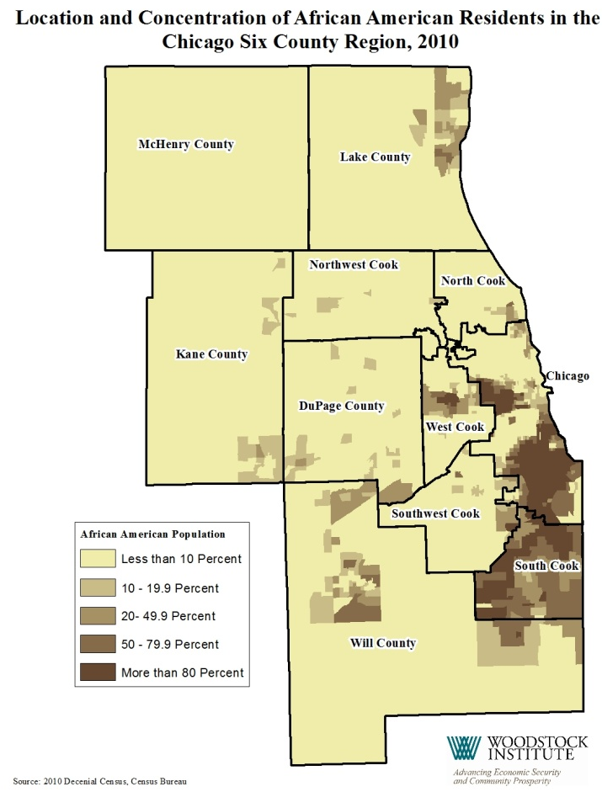
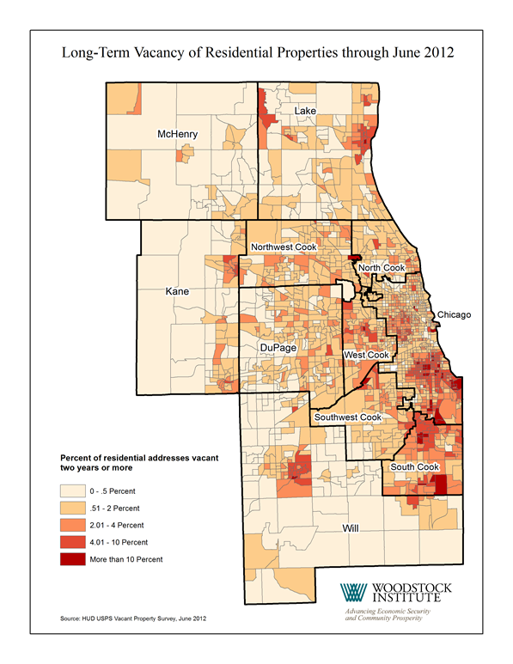
Race and Patterns of Distress

Slide 5
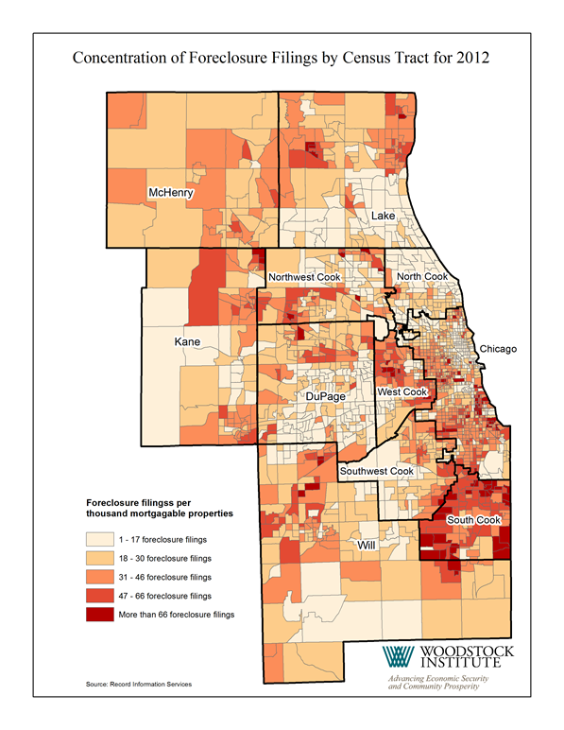
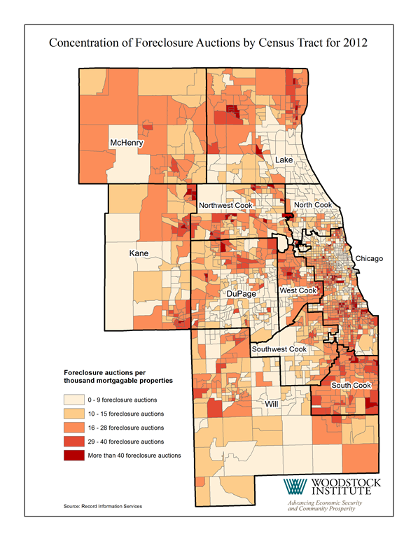
More Patterns of Distress

Slide 6
Chicago Data Analysis
Mortgage data for 4th Q 2011, zip code level, included:
  LTV range
  number of mortgaged properties
  total amount of mortgage debt
  total value of mortgaged properties
Merged with 2010 census data

Slide 7
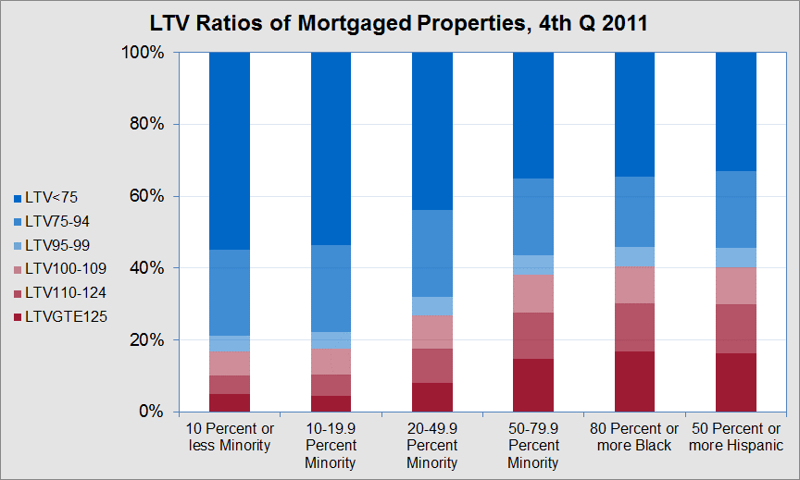
Negative Equity by Race

Slide 8
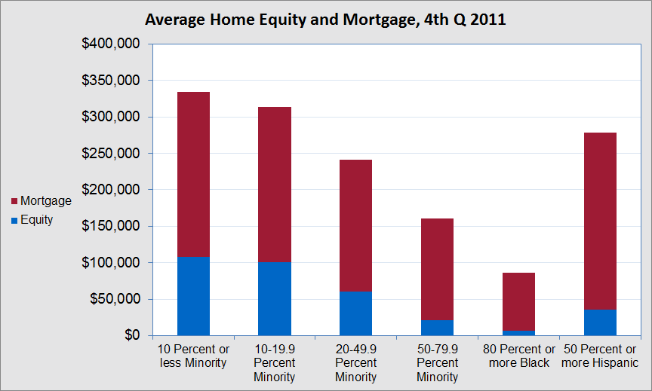
Home Equity by Race

Slide 9
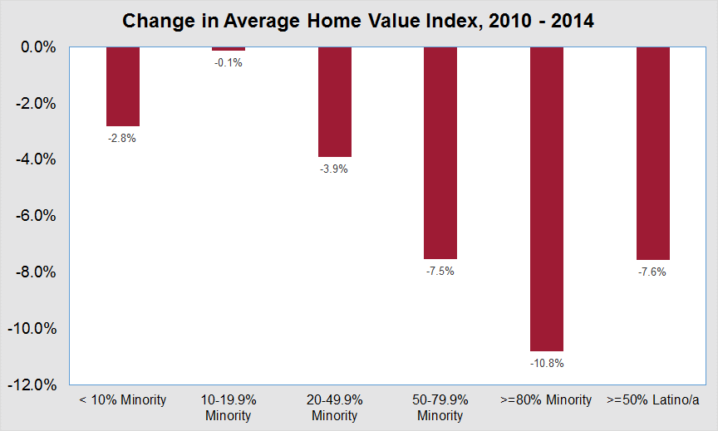
Uneven Recovery, 2010 to 2014

Slide 10
From Chicago to Atlanta
Source: Haas Institute for a Fair and Inclusive Society
Underwater America, 2015

Slide 11
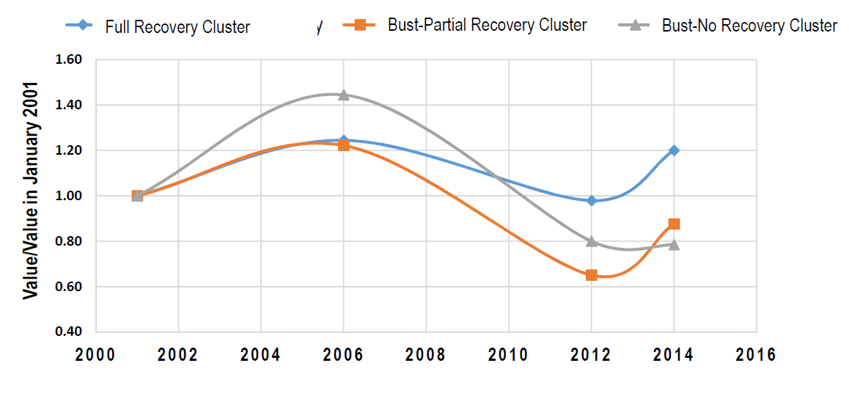
Bubble, Bust, and Some Recovery
Fully Recovered
Partially Recovered
Not Recovered
Source: Raymond, Elora, Kyungsoon Wang, and Dan Immergluck. 2015. Race and Uneven Recovery:
Neighborhood Home Value Trajectories in Atlanta before and after the Housing Crisis

Slide 12
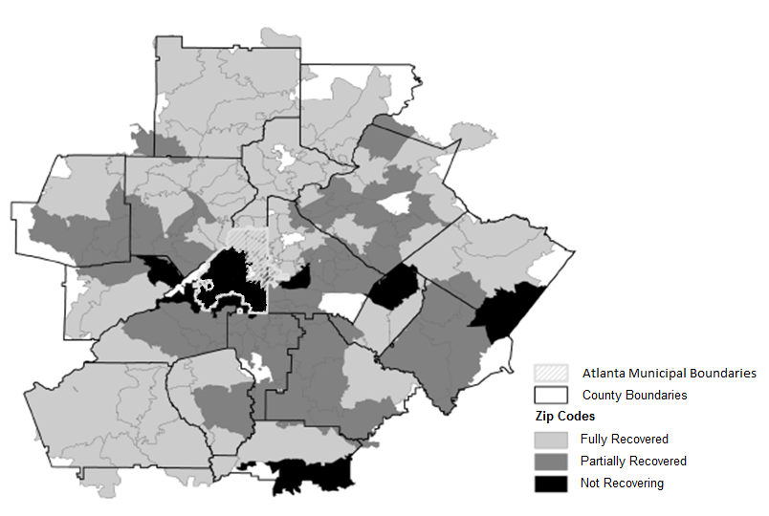
Uneven Recovery in Atlanta
Source: Raymond et als., 2015

Slide 13
Atlanta Region Data 2013
Based on 21 county region
Of the 50 zip codes nationally with the highest percentages of negative equity
  25 are in the Atlanta region
  9 of the top 10 are in the Atlanta region
  16 of the top 20 are in the Atlanta region
Source: Haas Institute for a Fair and Inclusive Society
Underwater America, 2015

Slide 14
25 Zip Code Data 2013
Between 56 and 76 percent of homeowners have negative equity
24 of the zip codes are majority African American or Hispanic
19 of the zip codes are 80 percent or more African American or Hispanic
They have a combined population of over 839,000
Source: Haas Institute for a Fair and Inclusive Society
Underwater America, 2015

Slide 15
Negative Impacts of Negative Equity
Drives foreclosures
  can’t refinance or downsize
  increase risk if LTV > 110
  7 times greater if LTV >150
Limits opportunity
  can’t move
Reduces incentive to maintain property
  increases blight, with spillover effects

Slide 16
Policy Implications
Need to find ways to get homeowners out of negative equity status
  principal reduction
  short sale, deed in lieu
Need to act soon
  avoid spillover
  threat of resets on HELOCs

Slide 17
Negative Equity:
A Continuing Problem
March 17, 2015
Spencer M. Cowan | Vice President
Woodstock Institute | Chicago, Illinois
P 312.368.0310 | F 312.368.0316
scowan@woodstockinst.org
@woodstockinst
WoodstockInstitute

